Slide 1
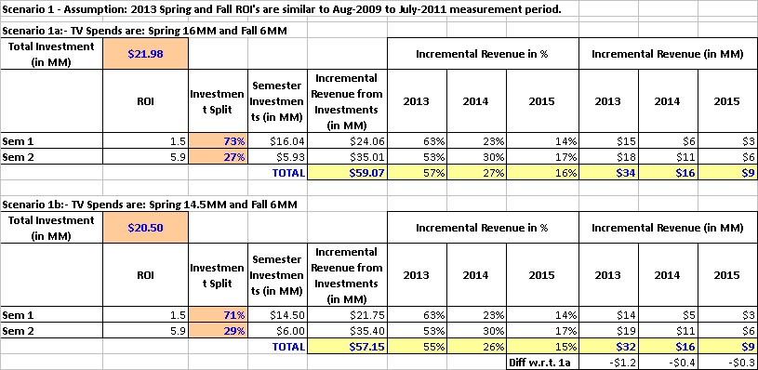
Projected Incremental Revenue from 2013 TV campaign
Assumption: ROIs will be similar as before.
Scenario 1a with 16MM Spring and 6MM Fall TV spend may generate $59MM ($34MM in 2013)
Scenario 1b with 14.5MM Spring and 6MM Fall TV spend may generate $57MM ($32MM in 2013)
Previous Nasonex TV analysis had study period between Aug-2009 to Jul-2011.
Minimum possible spends specified by GMC team was: Spring 14.5 MM and Fall: 6MM

Slide 2
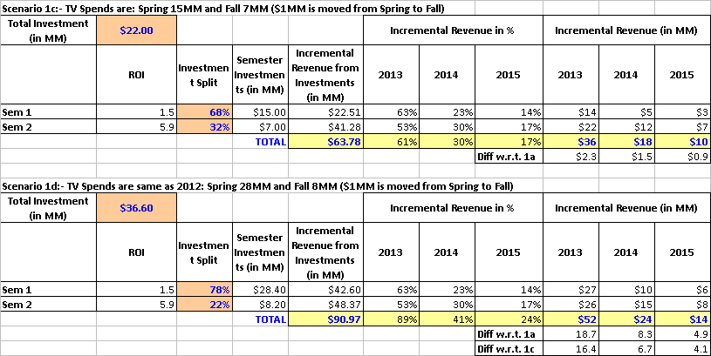
Projected Incremental Revenue from 2013 TV campaign – Additional Scenarios
Assumption: ROIs will be similar as before.
Scenario 1c with $1MM shifted from Spring to Fall may generate $63MM (+ $2.3MM in 2013)
Scenario 1d with spend similar to 2012 level of $36.6MM may generate $91MM (+ 18.7MM in 2013)
Previous Nasonex TV analysis had study period between Aug-2009 to Jul-2011.

Slide 3
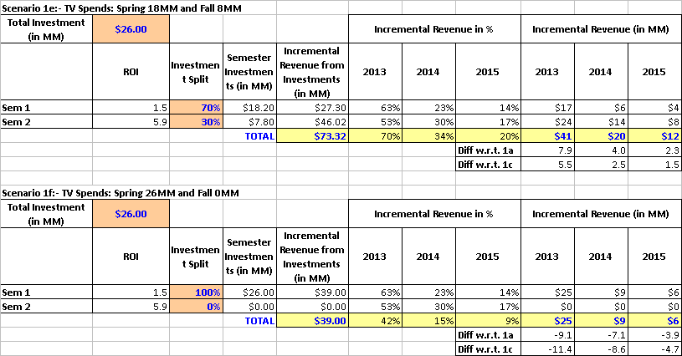
Projected Incremental Revenue from 2013 TV campaign – Additional Scenarios (cont’d)
Assumption: ROIs will be similar as before.
Scenario 1e Spring 18MM and Fall 8MM may generate $73MM ($41MM in 2013)
Scenario 1f Spring 26MM and Fall 0MM may generate $39MM ($25MM in 2013)
Previous Nasonex TV analysis had study period between Aug-2009 to Jul-2011.

Slide 4
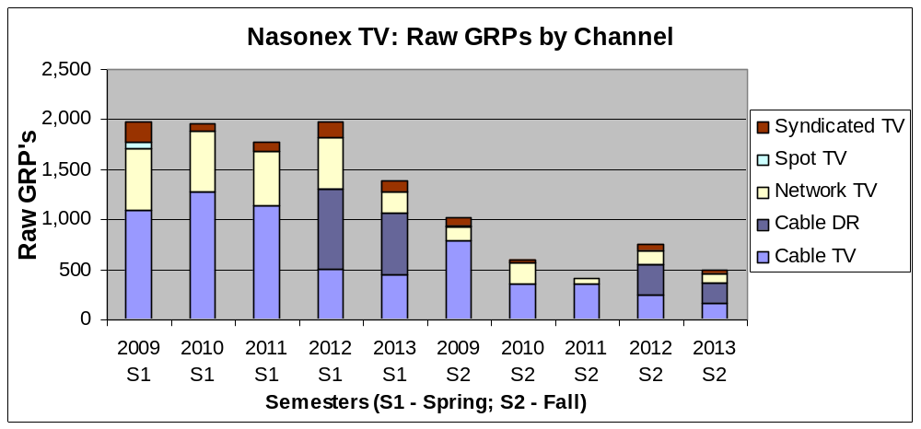
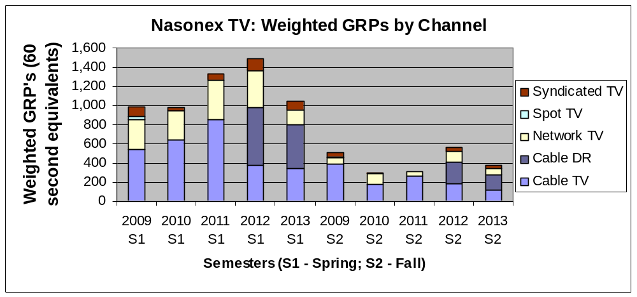
Comparison of TV ads between 2009 to 2012 vs. 2013(projected)
2013 has heavy Cable-DR component with lower spend in spring.
Previous Nasonex TV analysis had study period between Aug-2009 to Jul-2011.
The Spring total GRPs in weighted scale (i.e., 60 second equivalents) have slightly increased* in 2011 and 2012. 2013 is similar to 2009 and 2010.
Spend for Spring 2013 is almost ½ of Spring of 2011or 2012. Heavy “Cable – DR” in 2013 to increase the GRP with lower spend.
Spend in Fall is more or less constant across years (exception: 2012 fall spend and GRP were higher). “Cable-DR” is a heavy component for 2012 and 2013 Fall.
Given the differences in channel GRP distributions across years, the impacts per GRP may be different in 2013, but we do not know how much.
  If we assume that the impact per GRP is same like before, then the Spring 2013 ROI may double (from 1.5 to 3.0) since the spend is reduced by 50%.
  Given the unknowns, a safer assumption may be that ROI’s may be similar as before (instead of impact per GRP being same) and make projections on incremental revenue.
* There are some data quality issues being addressed for 2011 S1.

Slide 5
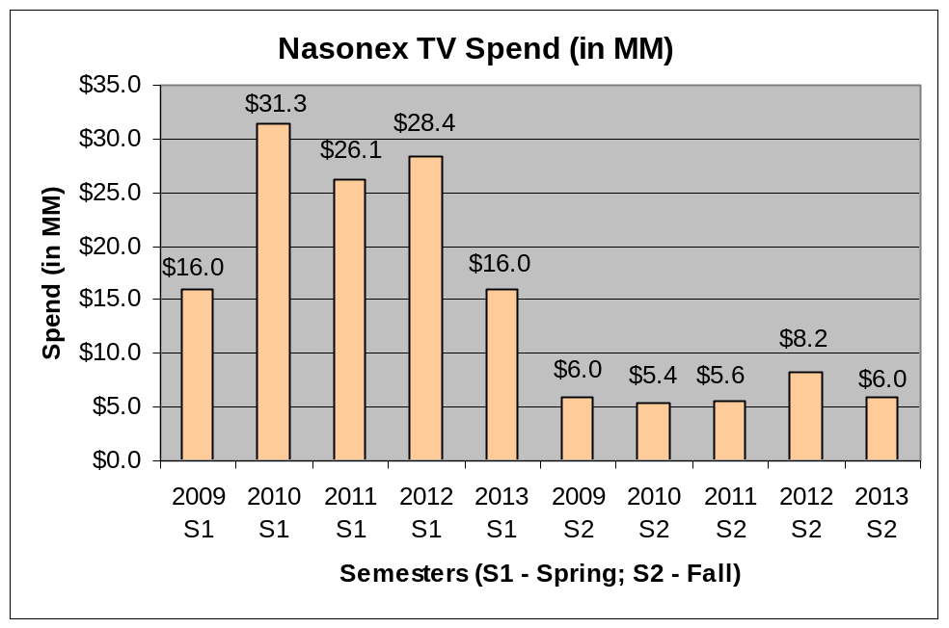
Comparison of TV spends between 2009 to 2012 vs. 2013(projected) (cont’d)
2013 has heavy Cable-DR component with lower spend in spring.

